Slide 1
THE HACKATHON
NETFLIX Insight Analysis for
CS-Streaming
PATRICJA – BLANKA – SHALMALI – ALICE – JEVGENIJS – YIANNIS – SARAH

Slide 2
Analysing Netflix Data Set for a New Streaming Service
Uncovering trends and insights about TV Shows and Movies
User Behaviour Preferences Visuals

Slide 3
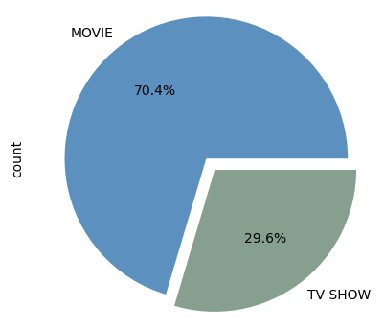
MOVIES VS TV SHOWS

Slide 4
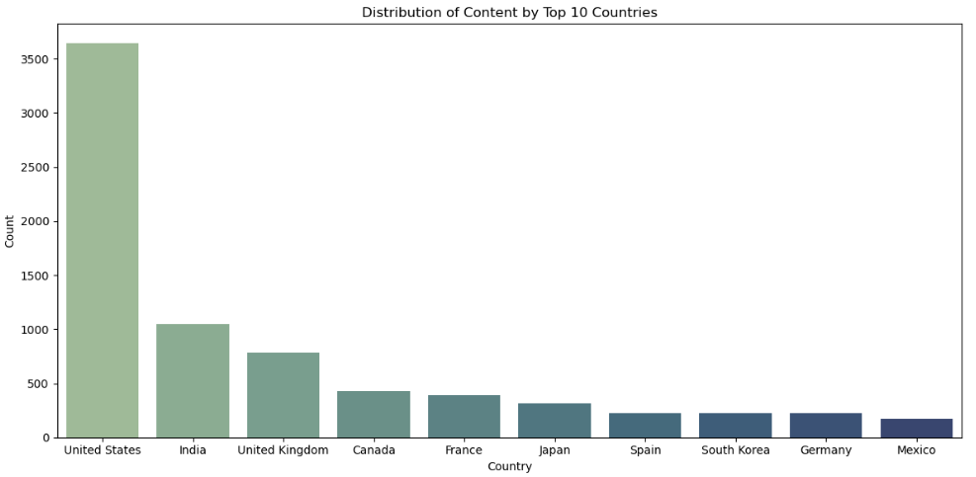
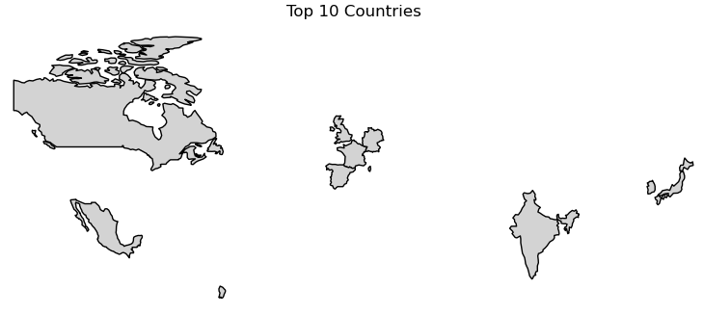
TOP 10 COUNTRIES BY CONTENT RELEASE

Slide 5
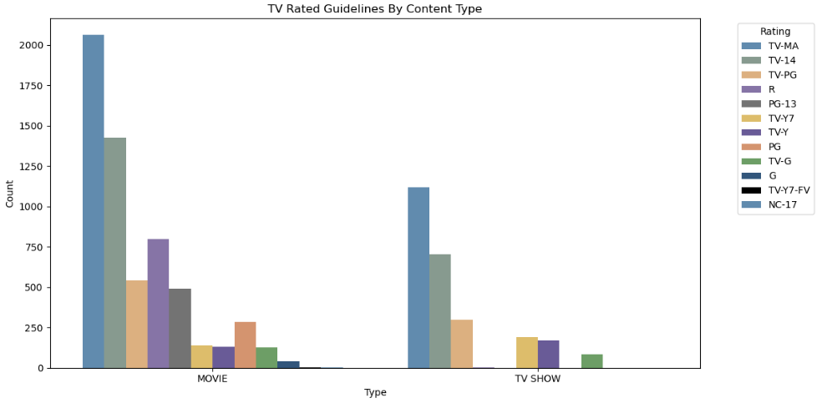
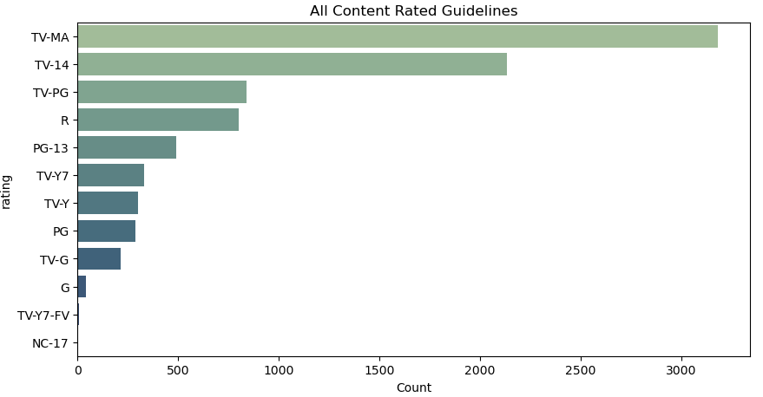
RATED GUIDELINES BY CONTENT TYPE

Slide 6
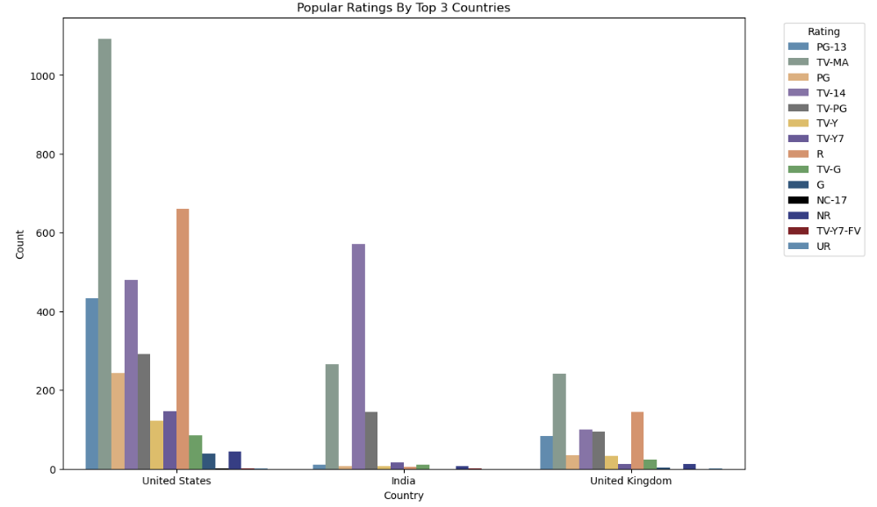
TOP 3 COUNTRIES MOST POPULAR CONTENT RATINGS

Slide 7
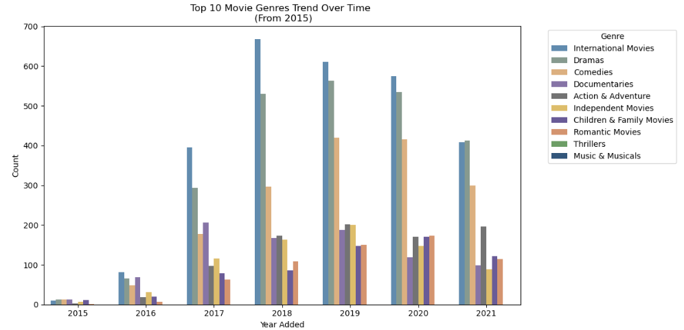
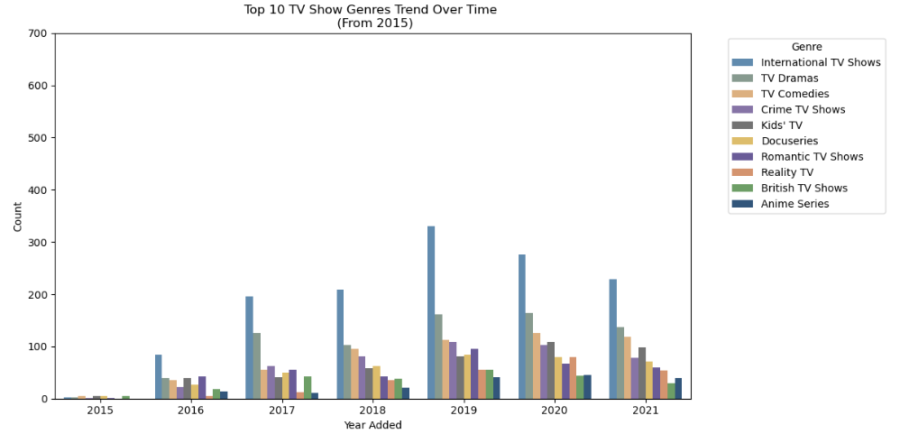
TOP 10 GENRES TREND OVER TIME (2015 - 2021) MOVIES VS TV SHOWS

Slide 8
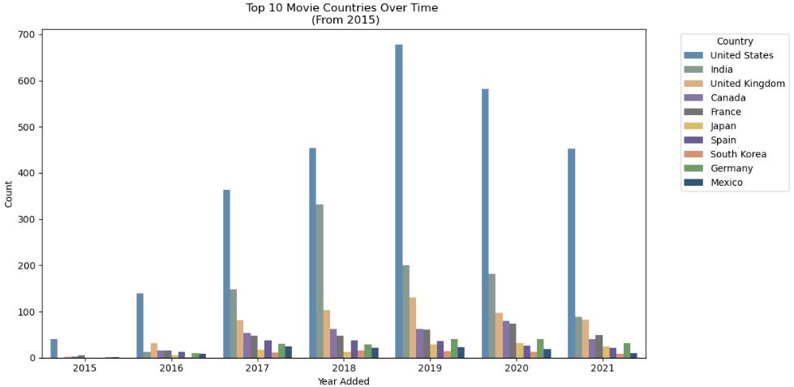
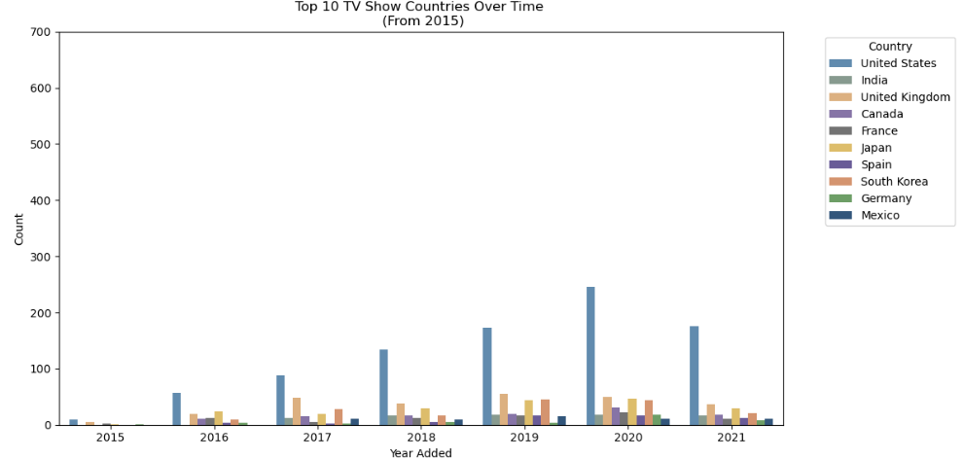
TOP 10 GENRES TREND BY COUNTRY OVER TIME (2015 - 2021) MOVIES VS TV SHOWS

Slide 9
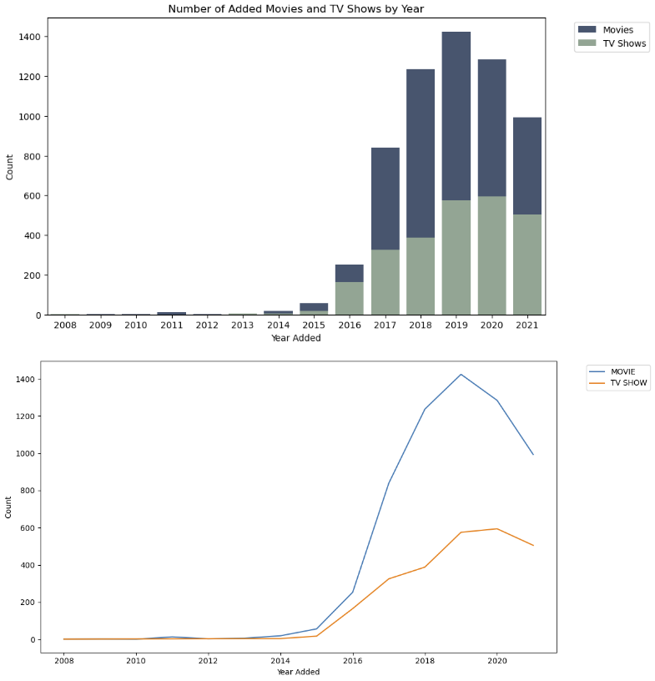
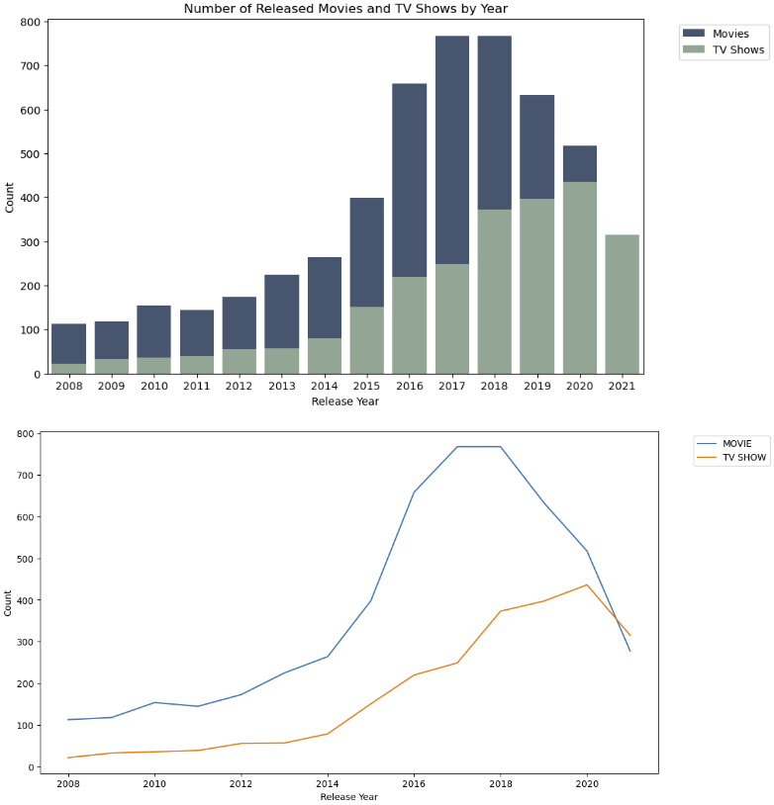
CONTENT ADDED VS CONTENT RELEASED OVER TIME (2008 - 2021)

Slide 10
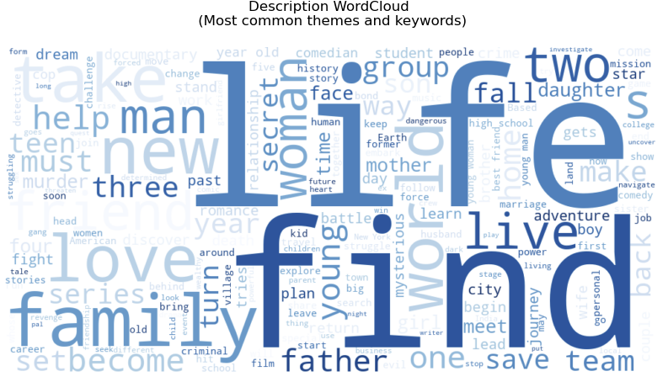
MOST COMMON DESCRIPTION KEYWORDS / THEMES

Slide 11
Content genres such as drama and comedy attract higher viewer engagement compared to others like documentaries.
CONCLUSION
Content can be customised by researching the demography and culture of the countries.
Recent releases are more likely to drive user engagement compared to older content.

Slide 12
Q & a’s

